Slide 1
Using Zephyr® RTOS on Microchip MCUs
Dan Tang
26017 RTOS1

Slide 2
Module Objectives
Attendees will be prepared to build their first project using Zephyr® OS, an open source RTOS
You will learn to create and debug projects in the Zephyr OS ecosystem
You will learn to use Zephyr OS Threads and Message Queues to enable inter-process communications
You will gain comfort using the Zephyr OS Devicetree to define and configure attached hardware and peripherals
You will learn to find published support documentation and use messaging apps to seek help

Slide 3
Agenda
Overview of Zephyr® OS
  Zephyr OS SDK, West and Zephyr OS Project Folder
  Finding Zephyr OS APIs
  Lab 1 – Blinky/Creating Your First Project
Zephyr OS Kernel Services
  Tasks and Inter-process Communication
  Lab 2 – Creating Threads and Queues
Zephyr OS Devicetree
  Devicetree Overview and Vocabulary
  .dtsi Files and Overlays
  Lab 3 – Using Console to Enable Wifi Connections with WINC1500
Zephyr OS Services and Finding Support
Summary

Slide 4
Overview of
Zephyr® OS

Slide 5
What is an RTOS?

Slide 6
Basic Superloop Code
#define LOOPDELAY 100ul
void main() {
setupBoard();
setupPeripherals();
while(true) {
// Gather Sensor Data
temperature = getTemperature(ADC_CHAN_1);
current = getCurrent(ADC_CHAN_2);
voltage = getVoltage(ADC_CHAN_3);
// Act on current sensor data
checkFaults(temperature, current, voltage);
serviceMotor(temperature, current, voltage);
serviceUI();
delayMS(LOOPDELAY);
}
}

Slide 7
RTOS Code - Threads
void Temperature() {
while(true) {
t = getADC(CH1);
convertTemp(t, T);
taskDelayMS(1000);
}
}
void main() {
setupBoard();
setupPeripherals();
createThread(Temperature);
createThread(Current);
createThread(Voltage);
createThread(Faults);
createThread(Motor);
createThread(UI);
startScheduler();
while(true) {
runScheduler();
}
}
Faults()
Motor()
void Current() {
while(true) {
i = getADC(CH2);
convertCurr(i, I);
taskDelayMS(10);
}
}
UI()
void Voltage() {
while(true) {
v = getADC(CH3);
convertVolt(v, V);
taskDelayMS(100);
}
}

Slide 8
RTOS - System Architecture
*Scheduler
Higher Priority Lower Priority
Faults
Motor
*Semaphore
*Event
*Message Queue
Temp
Current
ADC *Mutex
*Event
*Message Queue
Voltage
User Interface

Slide 9

What is Zephyr® OS
Real Time OS (RTOS)
Board Support Packages for many devices
Kernel Services and OS Services
Supported by Linux® Foundation and several large vendors
Open-Source Software

Slide 10
Zephyr® OS SDK
Toolchain (Compiler, Linker, Programmer)
CMake Based build environment
Hardware managed by DeviceTree
Board Support Packages (.dtsi, openOCD config, etc)
QEMU and Twister
Getting Started:
  https://docs.zephyrproject.org/latest/develop/getting_started/index.html

Slide 11
Zephyr® OS west meta-tool
“Swiss-army knife” tool for working with a Zephyr OS project
  west init: Create a new project folder and download Zephyr OS code (This has already been done to save lab time)
  west build: Build and compile code for a target
  west flash: Flash code to a target device
  west debug: Open a debug session to a target device
  Lots more… https://docs.zephyrproject.org/latest/develop/west/index.html
Python tool, typically installed in a VENV
  From your project directory:
    $>.venv/Script/Activate.ps1
west [common-opts] <command> [opts] <args>
  Ex: west build –p always –b samd21_xpro /samples/basic/blinky
West is pluggable and extendable to customize for your own project needs

Slide 12
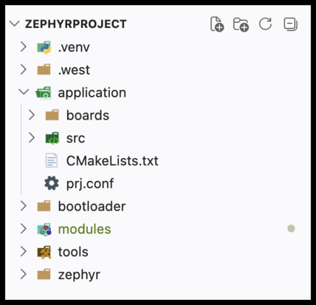
Zephyr® OS Project Folder
To Create a Custom Project, Add/Create:
  src/main.c
  boards
  CMakeLists.txt
  prj.conf
  Optional:
    Readme.rst
    sample.yaml
    git init
    .gitignore

Slide 13
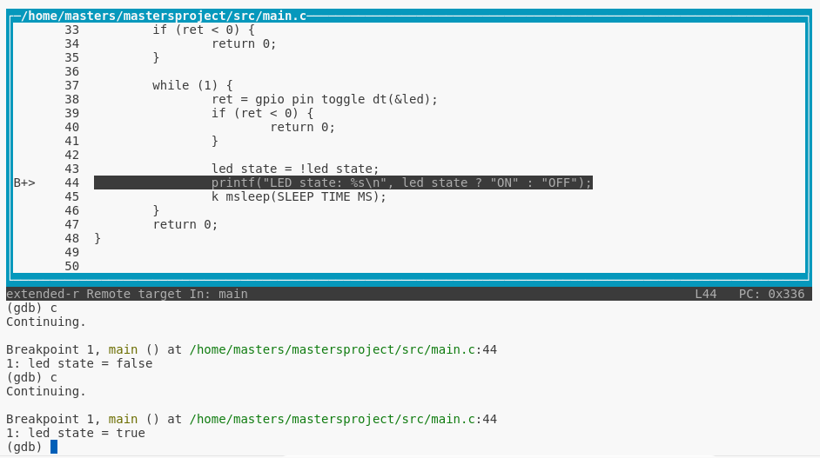
Debugging a Zephyr® OS Project
printk();
  Uses semihosting
  picocom or similar
west debug
  help
  tui enable
VSCode launch.json
  Requires cortex-debug

Slide 14
Zephyr® OS APIs
https://docs.zephyrproject.org/latest/doxygen/html/index.html
Demo – Navigate the Zephyr OS webpage

Slide 15
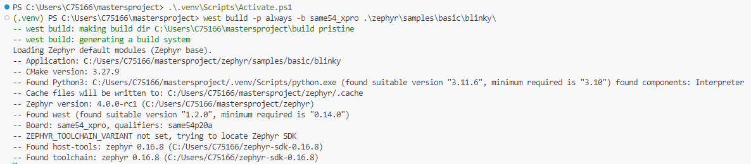
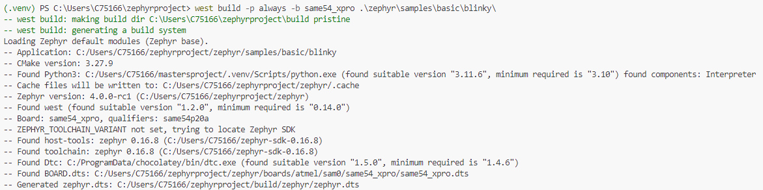
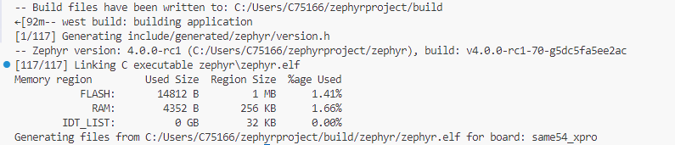
Lab 1: Build and Deploy a Sample Application, Then Create a New Project Tree
SUCCESS!

Slide 16
BZ6 OpenOCD Bugfix
There is a bug in the OpenOCD config for the BZ6 that prevents OpenOCD from halting the CPU so it can attach to it. While the fix for this has not been officially released yet, a temporary fix is available here: https://github.com/sarpuser/getting-started-with-zephyr/tree/main/bz6_bugfix
Go to that link and download “bugfix.patch”.
Run “git –C zephyr apply ../bz6_bugfix/bugfix.patch” to apply the patch

Slide 17
Lab 1: Summary
In this lab, you have learned how to navigate the Zephyr® OS project tree, build and flash sample code and build a skeleton framework for a new project.
Your project structure may look different if you want, this is just one way to lay out a project.

Slide 18
Zephyr® OS
Kernel Services

Slide 19
Zephyr® OS Kernel Services
Scheduling Services
  Threads, Idling, Interrupts, Semaphores, Mutexes, Events
Data Passing Services
  FIFO/LIFO, Message Queue, Mailbox, Pipe
Memory Management
  Heaps, Slabs, Blocks Allocator, Demand Paging, Virtual Memory
Timing
  Kernel Timing, Timers
Other
  Atomic Variables, Floating Point, Fatal Errors

Slide 20
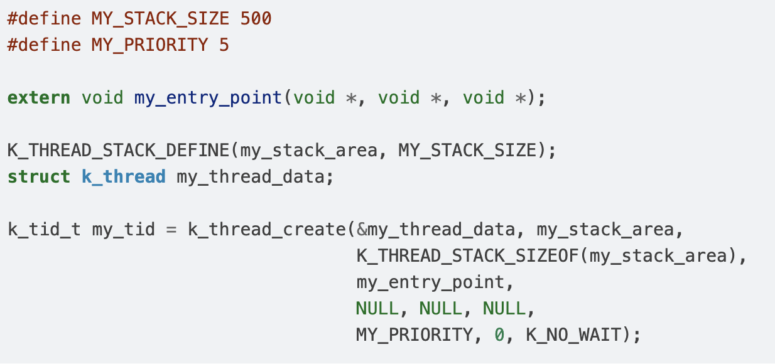
Using Zephyr® OS Threads
What is a Thread?
  “A thread is a kernel object that is used for application processing that is too lengthy or too complex to be performed by an ISR.”
  Any number of threads can be defined by an application (limited only by available RAM). Each thread is referenced by a thread id that is assigned when the thread is spawned.”
Initializing a thread:

Slide 21
Using Zephyr® OS Threads (Continued)
Using Priority
  Integers, lower numbers are
  higher priority
  Avoid Priority Inversion!!!
Passing in UserData (why?)
  void my_entry_point(void *, void *, void *);
RTOS Aware Delays/Yields
  k_msleep(); k_usleep(); k_yield();
Gracefully Ending a Task
  Release any shared resources (the scheduler won’t do it for you)
  k_thread_abort();
Higher Priority
Lower Priority
-7 -5 -3 0 3 5 7

Slide 22
Communicating Between Tasks
Counting Semaphore
  Allows threads to “borrow” and “return” (take/give) a certain number of a specified resource
  count indicates the number of times a semaphore is available to be taken
  A limit indicates the maximum value of semaphore’s count
Message Queue
  Allows threads and ISR’s to send/receive fixed length items asynchronously
Mutex
  Allow threads to safely share access to a resource, restricting usage to one at a time
Event
  Inter-thread communication indicating something has occurred (timer, button press, analysis complete, shutdown, FAULT)
  Many threads can listen for a given event

Slide 23
Lab 2: Creating Zephyr® OS Tasks and Queues
In this lab, you will create a producer task that delivers a count to a message queue and a consumer task that prints the count when it’s received
Communications between tasks done via Message Queue

Slide 24
Lab 2: Summary
In this lab, you created new project source (.c) and header (.h) files, updated your CMakeLists.txt file to include these new files, and built two tasks of similar priority with a Message Queue to communicate data between them.
How else might you use one or more threads in your own projects to replace the cooperative multitasking loop?
As you move forward using threads, try to become more “Event Based” rather than polled.

Slide 25
Zephyr® OS
DeviceTree

Slide 26
Zephyr® OS Devicetree
What is Devicetree?
  Used to describe the presence of hardware and how that hardware should be configured
  Hierarchical – lower layers can be overlayed with more definitive descriptions
  Allows for software to target multiple boards by calling “aliases” defines for each board
Devicetree Compilation
Zephyr and Application Source Files
Devicetree Sources
Devicetree Overlays
Devicetree Compiler
devicetree.h
Devicetree Bindings

Slide 27
Zephyr® OS - Parts of a Devicetree Source
Node – an object in a Devicetree source (.dtsi)
  / (root node) – collection of sub-nodes
  Nested nodes: ex: /soc/sercom3/spiflash@0
Properties
  Describe the configuration of the current node
  Properties can be integers, strings, phandles/arrays, booleans
  ex:
  status= “okay”;
  compatible=“atmel,sam0-spi”;
  dpio = <0>;
  cs-gpios=<&porta 13 GPIO_ACTIVE_LOW>, <&portb 6 GPIO_ACTIVE_LOW>;
  requires-ulbp;

Slide 28
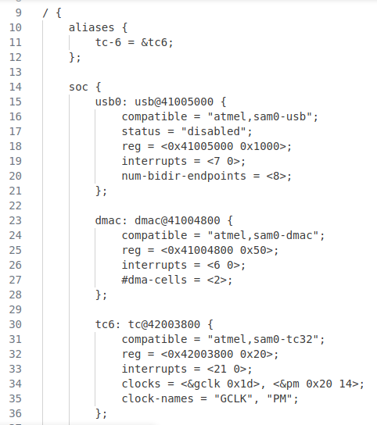
Zephyr® OS – Sample Device Tree Source
Root Node
Aliases
Parent Node
Child Node
Properties

Slide 29
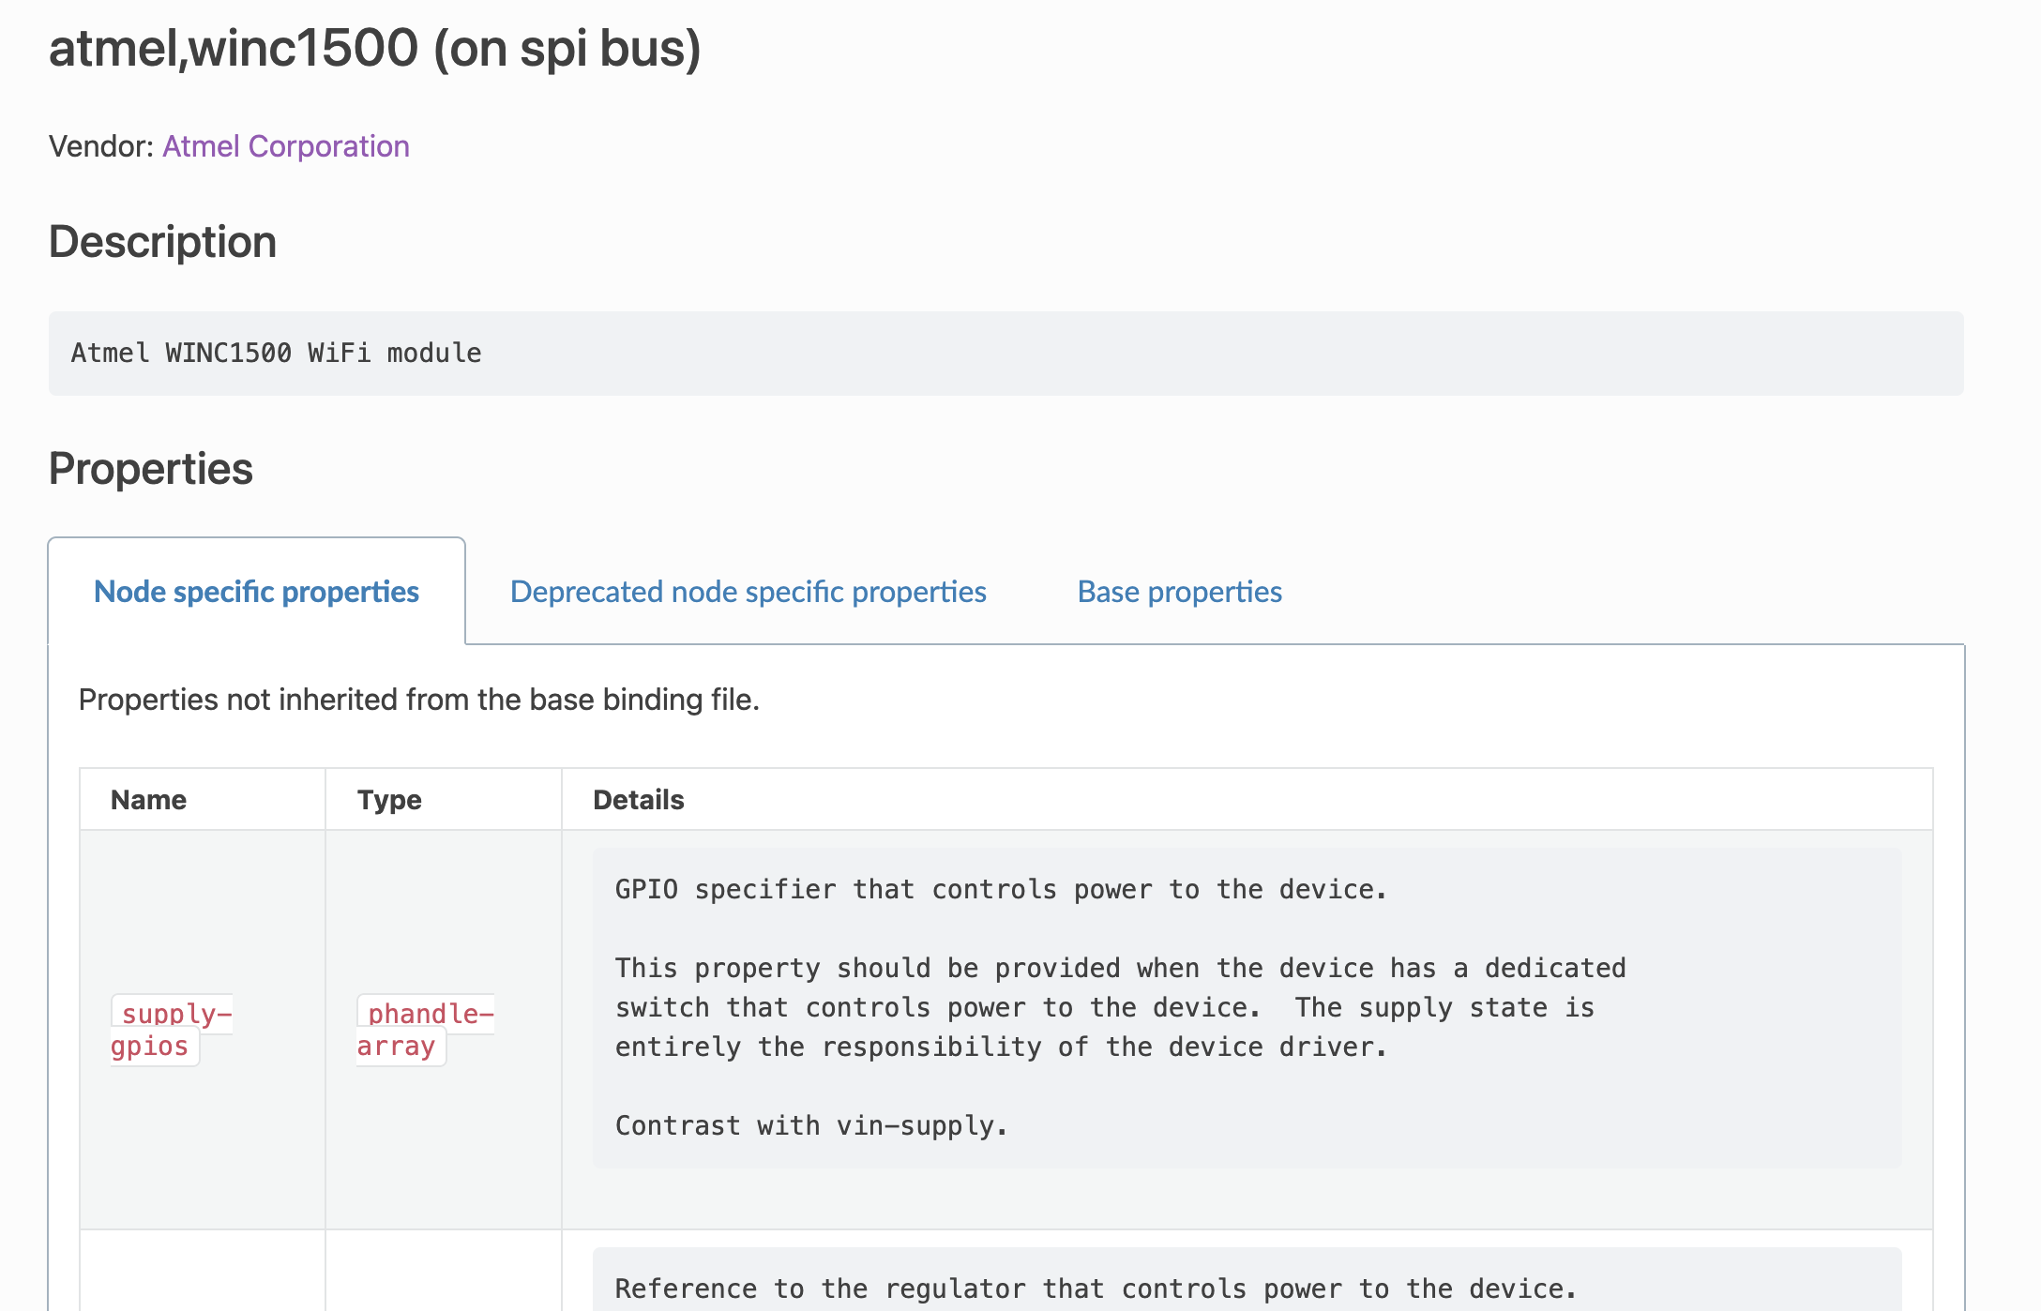
Zephyr® OS Devicetree
Demo: Finding a Devicetree Binding API
https://docs.zephyrproject.org/latest/build/dts/api/bindings.html

Slide 30
Zephyr® OS Devicetree
What is an Overlay?
Using an Overlay to extend or change a Device Configuration
<SOCdevice>.dtsi ->
nodeA { prop = <2> }
zephyr/<board>.dtsi ->
nodeA { prop = <0xFF> }
boards/<board>.overlay ->
nodeA { prop = <0> }
devicetree .h
nodeA { prop = <0> }

Slide 31
Zephyr® OS - Using a Devicetree Device in Your Code
Get a node identifier
/* Option 1: by node label */
#define MY_SERIAL DT_NODELABEL(serial0)
/* Option 2: by alias */
#define MY_SERIAL DT_ALIAS(my_serial)
/* Option 3: by chosen node */
#define MY_SERIAL DT_CHOSEN(zephyr_console)
/* Option 4: by path */
#define MY_SERIAL DT_PATH(soc, serial_40002000)
Get a device handle
const struct device *const uart_dev = DEVICE_DT_GET(MY_SERIAL);
if (!device_is_ready(uart_dev))
{
/* Not ready, do not use */
return -ENODEV;
}

Slide 32
Zephyr® OS – Configuring prj.conf
prj.conf holds a list of configuration defines
  CONFIG_GPIO=y
  CONFIG_NET_TX_STACK_SIZE=2048
Compile Time Flags that Enable/Disable/Configure content
Kconfig Search
  Kconfig Search — Zephyr Project Documentation
Editing prj.conf
  Text edit – prj.conf
  west build -t menuconfig – uses menuconfig
  west build -t guiconfig – opens a GUI window

Slide 33
Lab 3: Adding Wi-Fi™ with Devicetree
Use the “lm75” devicetree binding to describe the configuration of the IO1 XPRO on EXT1
Once connected, engineer will query the I2C bus for the temperature sensor

Slide 34
Lab 3: Summary
The console operation is managed in i2c_shell.c and Sensor API. These serve as great code examples as you move from debug/test into programmatic sensor products.

Slide 35
OS Services and
Finding Help

Slide 36
Zephyr® OS Services
Many more built in “goodies” to make development more efficient:
  Console/Shell
  File Systems
  State Machine Framework
  Power Manager
  Logging System
  Task Watchdog
  Modem (GNSS, Wi-Fi, Cellular)
  Unit Testing Framework (twister)

Slide 37

Getting Support
Official Zephyr® OS Docs
Discord Server
Mailing Lists
Wiki
YouTube Training
Social Media
Me (or your Microchip Technology Inc. FAE/CAE)
Notes:
DAM ID: 253954

Slide 38
Thank You!

Slide 39
LEGAL NOTICE
MASTERs 2026
Software:
Microchip software provided to you during the MASTERs 2026 conference is provided “AS IS”, without warranty. Microchip assumes no liability or responsibility for your use of any Microchip software. You must use Microchip software exclusively with Microchip products. Further, use of Microchip software is subject to copyright and the disclaimers and license terms accompanying such software, whether set forth at the install of each program or posted in a header or text file.
Notwithstanding the above, certain components of software offered by Microchip and 3rd parties may be covered by “open source” software licenses, including licenses that require that the distributor of such software make the software available in source code format. To the extent required by any such open-source software license, the terms of such license govern.
Any transfer of Microchip product, technology, or software may be subject to export controls. Microchip encourages any entity transferring product, technology, or software to seek appropriate legal advice and/or consult the applicable governmental agencies prior to transfer. The information provided herein is subject to change at any time and without notice.
Notice & Disclaimer:
Materials, software and accompanying information (including, for example, any references to 3rd party companies and 3rd party websites) are for informational purposes only and are provided “AS IS.” Microchip assumes no responsibility for statements made by 3rd party companies, or materials or information that such 3rd parties may provide.
MICROCHIP DISCLAIMS ALL WARRANTIES, WHETHER EXPRESS, IMPLIED, OR STATUTORY, INCLUDING ANY IMPLIED WARRANTIES OF NONINFRINGEMENT, MERCHANTABILITY AND FITNESS FOR A PARTICULAR PURPOSE. IN NO EVENT WILL MICROCHIP BE LIABLE FOR ANY DIRECT OR INDIRECT, SPECIAL, PUNITIVE, INCIDENTAL, OR CONSEQUENTIAL LOSS, DAMAGE, COST, OR EXPENSE OF ANY KIND RELATED TO THESE MATERIALS OR ACCOMPANYING INFORMATION PROVIDED TO YOU BY MICROCHIP OR OTHER THIRD PARTIES, EVEN IF MICROCHIP HAS BEEN ADVISED OF THE POSSIBLITY OF SUCH DAMAGES OR THE DAMAGES ARE FORESEEABLE. PLEASE BE AWARE THAT THE IMPLEMENTATION OF INTELLECTUAL PROPERTY PRESENTED IN MASTERs 2026 MAY REQUIRE A LICENSE FROM MICROCHIP OR THIRD PARTIES.
Trademarks:
The Microchip name and logo and the Microchip logo are registered trademarks of Microchip Technology Incorporated in the U.S.A. and other countries. Information on and a listing of Microchip trademarks is available at https://www.microchip.com/en-us/about/legal-information/microchip-trademarks.
All other trademarks mentioned herein are property of their respective companies.
COPYRIGHT:
© 2026 Microchip Technology Incorporated, All Rights Reserved.

